Slide 1
Testing Servo, the Parallel Browser Engine Project
David Schumann, Johannes Linke

Slide 2
Agenda
Project Overview
5 V&V Questions
Current Testing Status
Test Automation
Automatic Static Analysis

Slide 3
Project Overview
New browser engine by Mozilla
Long Term: Replace Firefox’s current engine Gecko
Goals in 2016:
Ship one Rust component in Firefox Nightly
Windows port
Explore new areas for performance improvements
Continue adding web platform features
Notes:
areas for improvement (GPU CSS rendering)

Slide 4
5 V&V Questions
When does V & V start? When is it complete?
Began with 6th commit, probably never ends.
What particular techniques should be applied during development?
Generating and checking coverage support on every PR
How can we assess the readiness of a product?
Hard to say for a research project. Main goal is still far away
How can we control the quality of successive releases?
See 2. V&V Question. Mozillas internal processes are not known
How can the development process itself be improved?
The process is already solid. Hard to improve without investing significant amount of time and money.
Notes:
Endet mit dem letzten PR
Automatischer coverage report check beim PR
Schwer zu sagen bei Forschungsprojekt. Großer Meilenstein Gecko zu ersetzen noch +15 Jahre entfernt.
see 2. Wir kennen die Mozilla internals nicht, aber da sollte ein Product owner existieren
Ist bereits ein sehr standartisierter Prozess. Abgesehen von ASA nicht ohne viel Geld/Zeit-Aufwand verbesserbar.

Slide 5
Current Testing Status
~110,000 LOC, ~11,000 tests
Called by "./mach test"
./mach test-wpt
./mach test-unit
./mach test-jquery
./mach test-tidy
Currently about 70-80 intermittently failing tests

Slide 6

Validation and Defect Testing
Test suite is focused on validation testing
Some scattered defect testing (e.g. acid2 test)

Slide 7
Development, Release and User Testing
Hard to separate
Core development team combines developers, release testers and users
Outside perspective on readiness and validity might be missing

Slide 8
Unit-, Integration- and System-testing
Unit tests only make up a fraction of the test suite
Integration tests are used in some dependencies
>95% of tests execute the servo binary and tests it's output

Slide 9
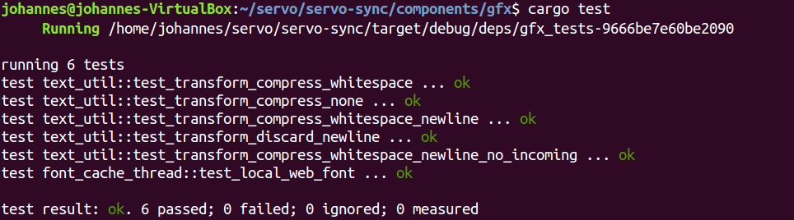
Test Automation - cargo test
To test your Rust program:
1. Annotate method with #[test]
2. run ‘cargo test’
3. No third step required

Slide 10
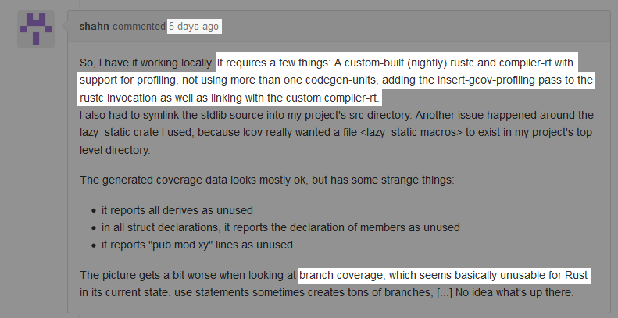
Test Automation - gcov

Slide 11
Test Automation - kcov
Works on all binaries with debug symbols
Inserts breakpoints
Dead slow (30s per test)
Broken accumulation

Slide 12
Test Automation - afl.rs
American Fuzzy Lop in Rust
Feeds input data over stdin to program under test
Mutates input data to get branch coverage
Tries to crash the program

Slide 13
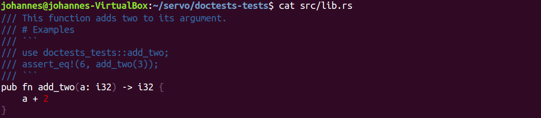
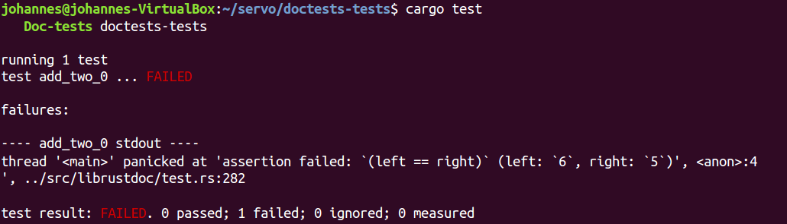
Test Automation - doctests

Slide 14
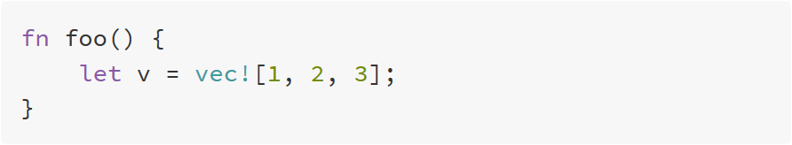
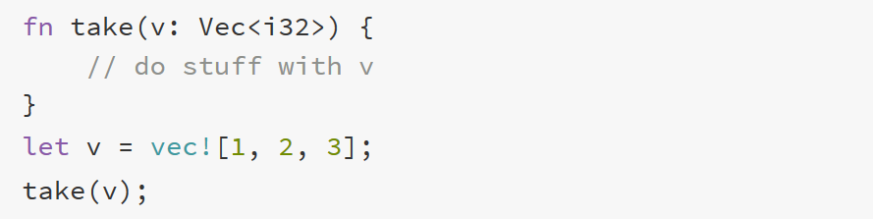
Automatic Static Analysis: Ownership
variable binding
‘owned’ by a scope
takes ownership of v
‘move’ v into take

Slide 15
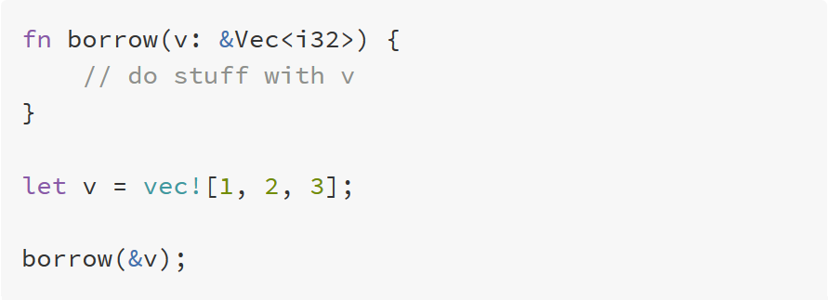
Automatic Static Analysis: Borrowing
take v by reference
‘borrow’ v to method

Slide 16
Automatic Static Analysis: Prevented Bugs
No accesses to uninitialized memory
No double frees
No use after free
No null pointers
No data races
No iterator invalidation
No memory leaks (kinda)
No garbage collector

